Slide 1
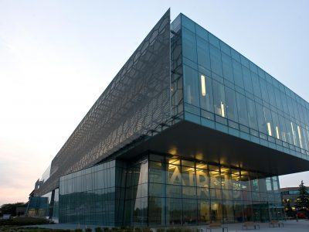
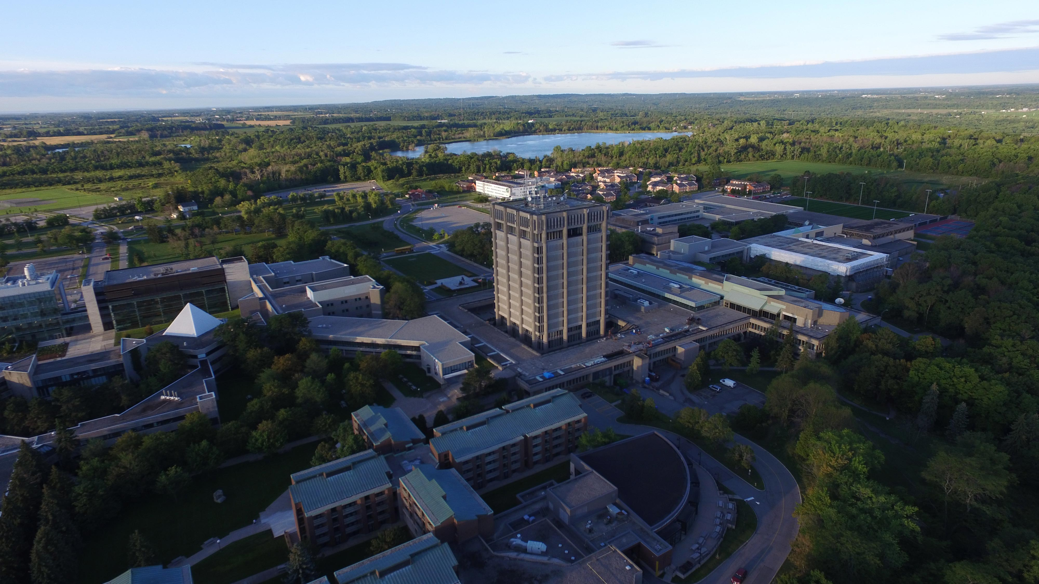
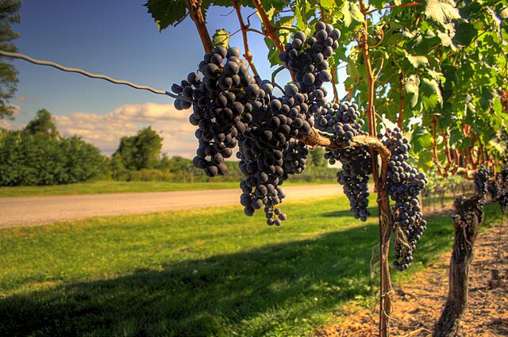
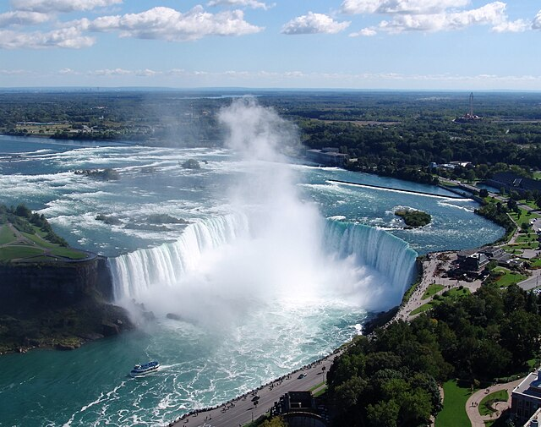
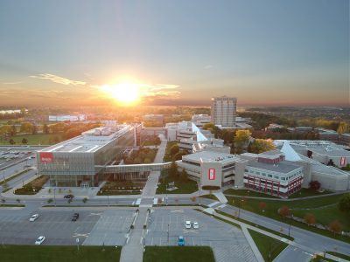
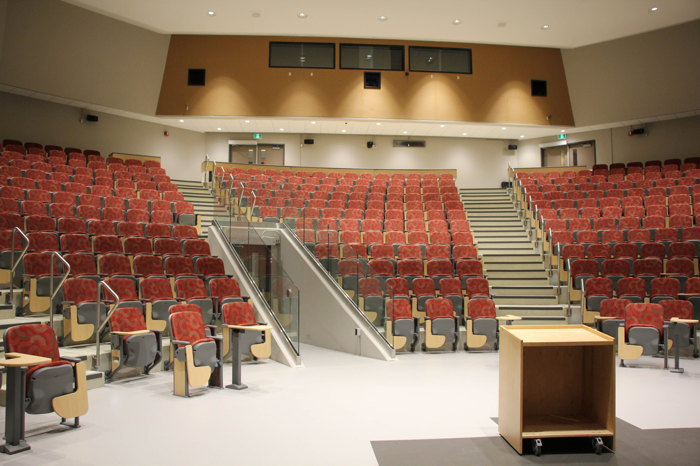
OE3C 2026 May 14-16, 2026 Brock University Coexisting with nature: life in the Niagara escarpment biosphere

Slide 2
OE3C 2026 May 14-16, 2026 Brock University Coexisting with nature: life in the Niagara escarpment biosphere

Slide 3
OE3C 2026 May 14-16, 2026 Brock University Coexisting with nature: life in the Niagara escarpment biosphere

